Slide 1


Titolo presentazione sottotitolo
Systems and Methods for Big and Unstructured Data Project
Lorenzo Biasiolo – 10629367 Grecya D’Angiò - 10651939
Elia Maggioni – 10610008 Enrico Maria Marinelli – 10898730 Carlos Santillán - 10659783
Milano, XX mese 20XX
Group 7
Academic Year 2022-2023

Slide 2

Systems and Methods for Big and Unstructured Data Project
Lorenzo Biasiolo – 10629367 Grecya D’Angiò - 10651939
Elia Maggioni – 10610008 Enrico Maria Marinelli – 10898730 Carlos Santillán - 10659783
Group: 7 – Academic Year 2022-2023

Slide 3
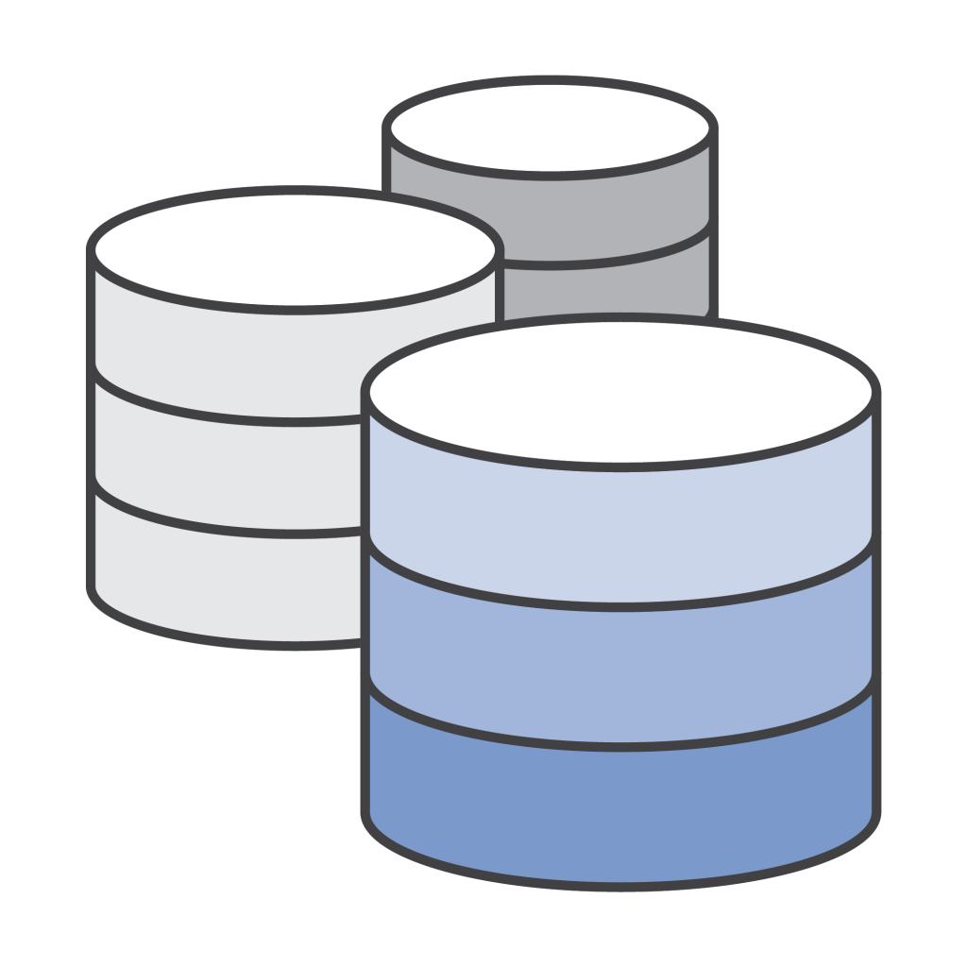

1. Problem presentation and assumptions:
Bibliography database
DBLP website

Slide 4
1. Problem presentation and assumptions:
An author can be affiliated to one and only one organization.
There is no distinction between the authors of the same publication, no ranking nor order.
We assume they all have contributed equally to the publication.
A publication X must cite at least one other publication, but it is admissible that no one has cited (referenced) X.
There are no joint publishers (i.e., publishers that share publication rights for the publications). Each publication must have one and only one publisher (even if it is presented at a conference).
Publications stored in the database can either be books or articles. No other types exist. It could eventually be expanded to include works like Ph.D. theses and independent publications.
Each article must be presented in one venue regardless of the type of venue.
A publication cannot reference itself.
Whenever we see missing values in the dataset we set them to a default value.

Slide 5
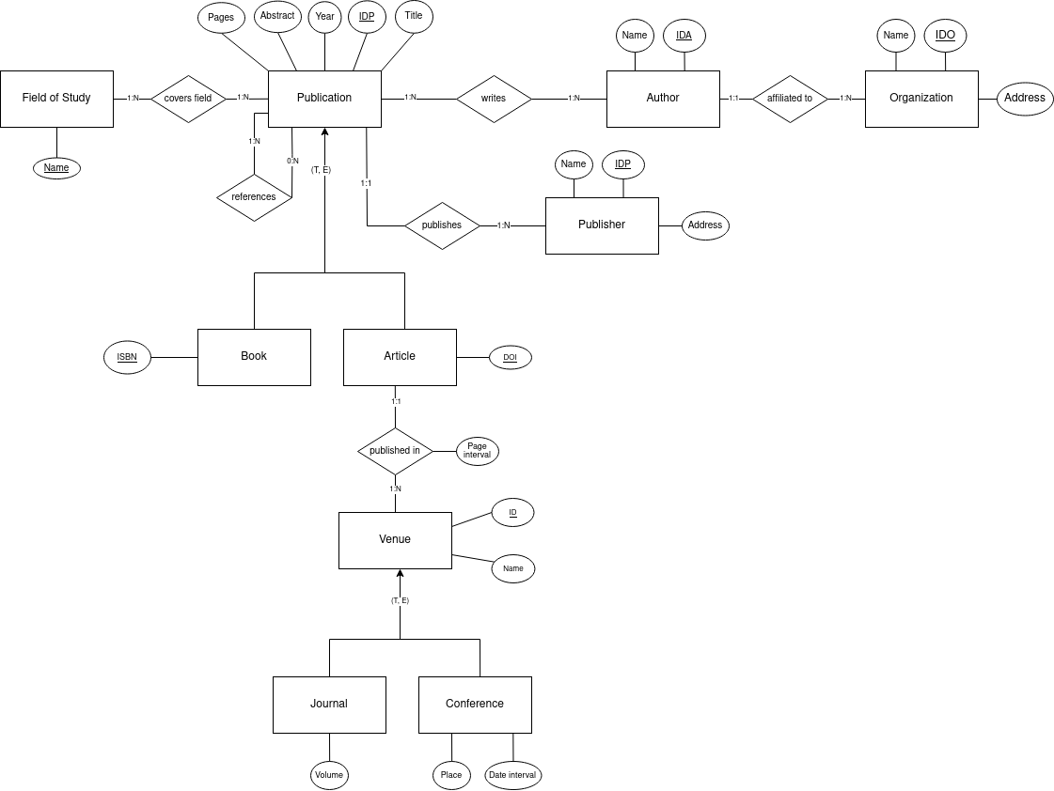
2. ER diagram

Slide 6
2. ER diagram

Slide 8
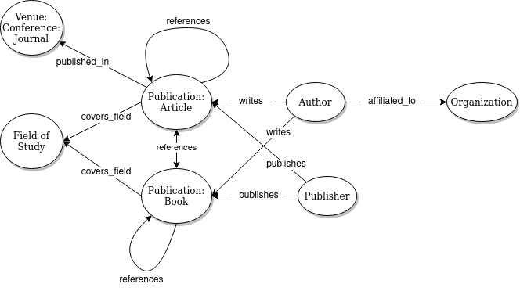

3. Neo4J
Useful to research the relationships of the different parts of the schema

Slide 9
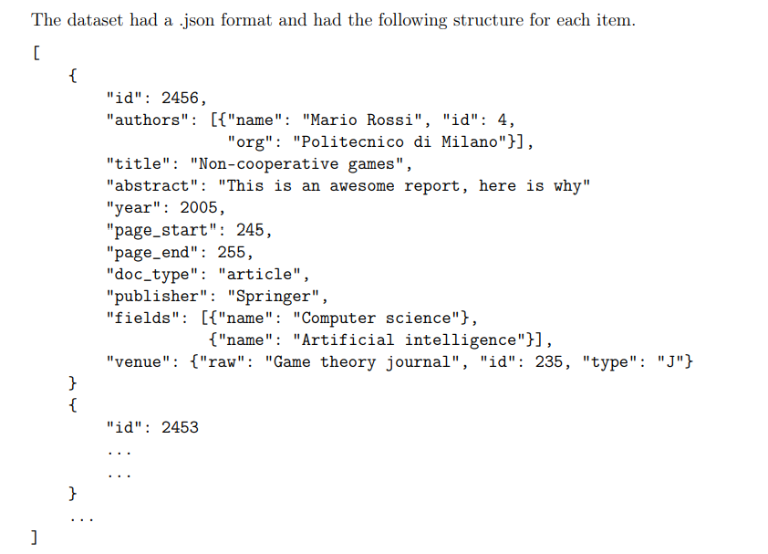
3.1 Neo4J Data Structure

Slide 10
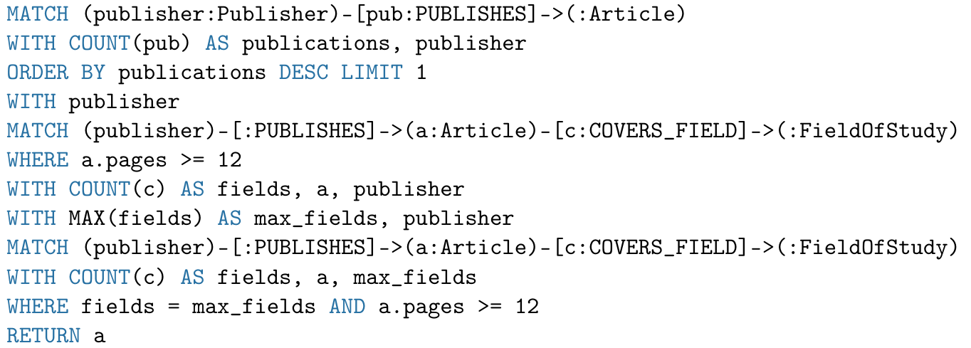
3.2 Query
Find the articles (with at least 12 pages) that cover the most fields by the publisher who has published the most articles

Slide 11

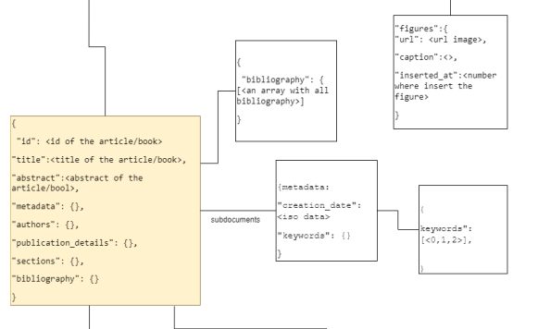
4. MongoDB
Useful to store elements together, flexible structure
Documental DB
How do we create the collection?

Slide 12
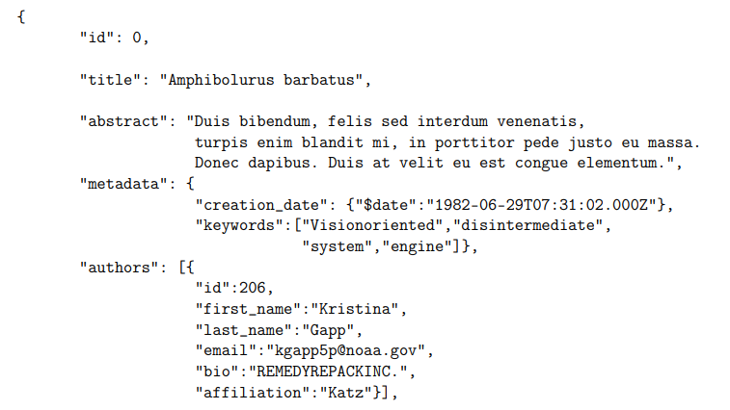
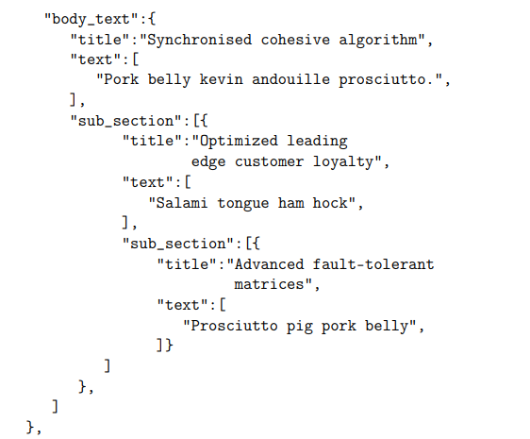
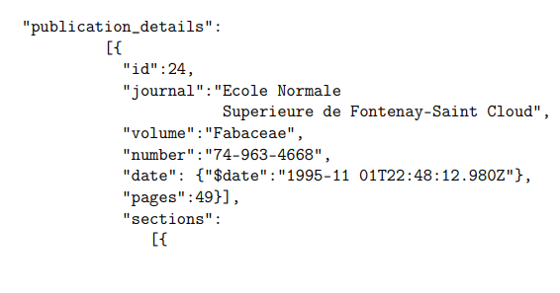
4.1 MongoDB Data Structure

Slide 13
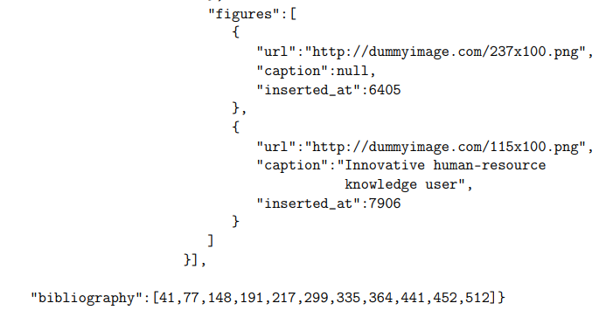
4.1 MongoDB Data Structure

Slide 14
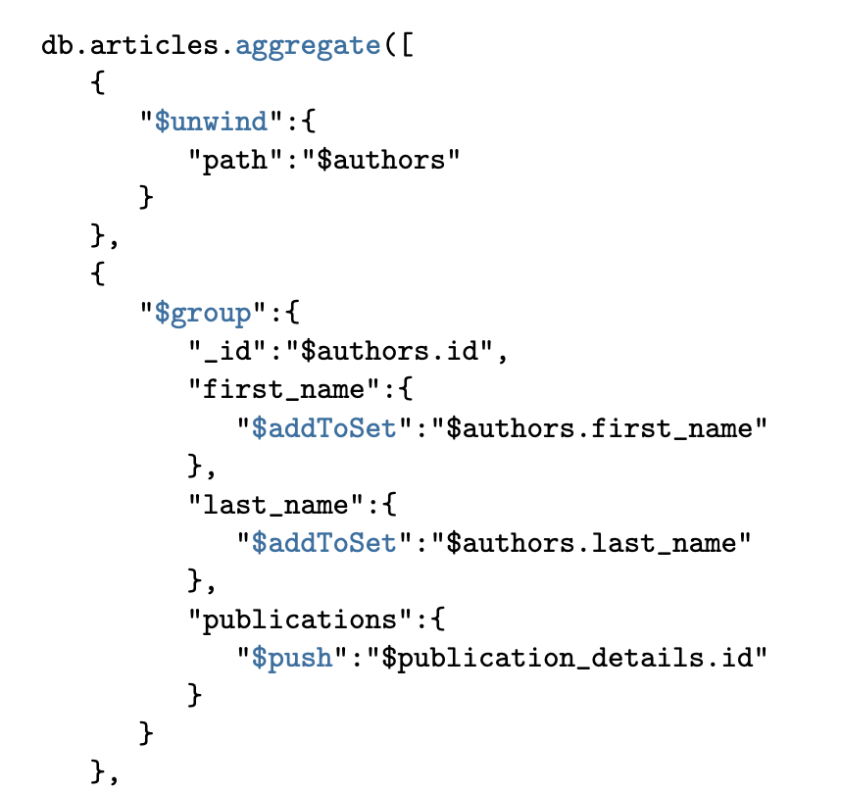
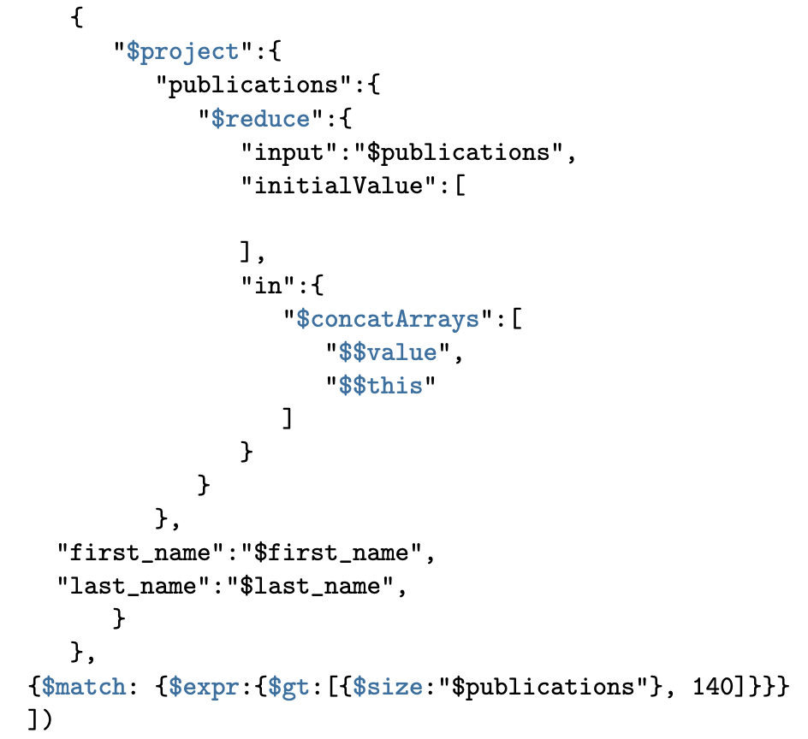
4.2 Query
Find authors id who have more than 140 publications

Slide 15
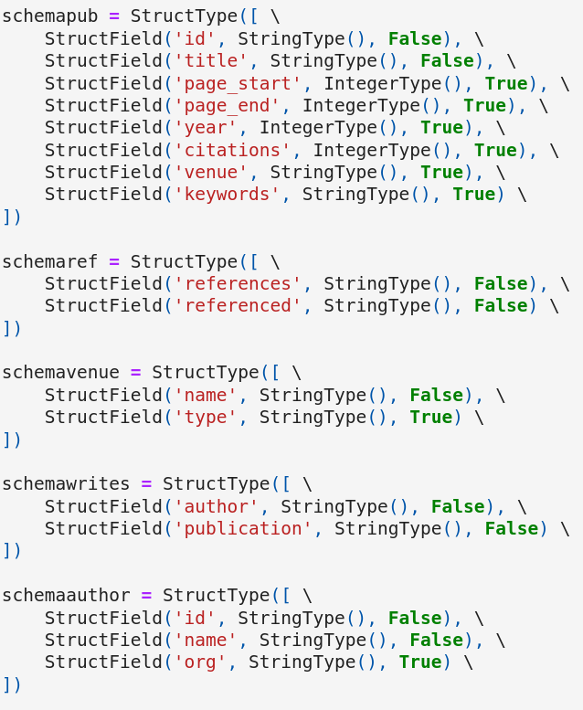
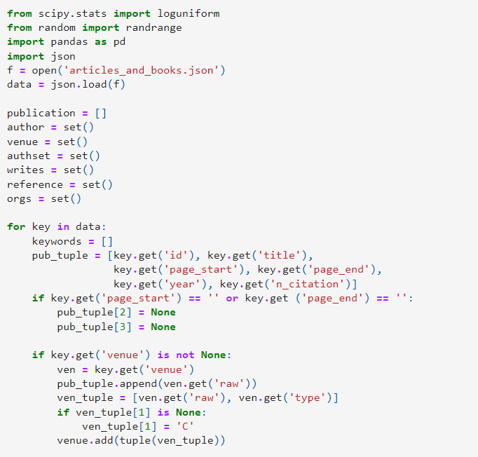

5. Spark Data Structure
author.csv
Fast
Easy
General
Compute huge quantity of data
Columnar approach
publication.csv
reference.csv
venue.csv
writes.csv

Slide 16
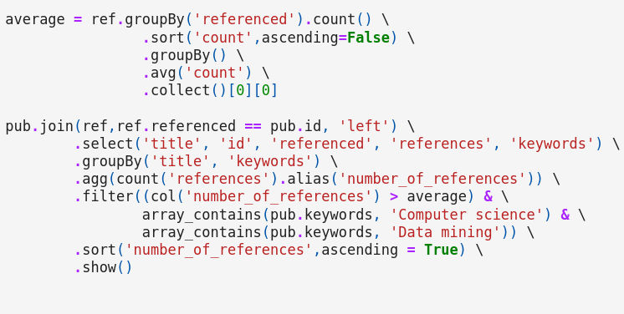
5.1 Query
Find publications that are referenced more than the average that contain the keywords 'Data Mining' and 'Computer Science', ordered by the number of publications in ascending order.

